Slide 1

Database Management System
STOCK AND DISTRIBUTION OF IICT STORAGE
01

Slide 2

Team Member
Nurul Madina Rahik
Reg no:2020831006
MD Abid Hasan Rifat
Reg no: 2020831030
Gilman MD Rejuan
Reg no: 2020831041
02

Slide 3








Process Overview
Application
Approval
Purchase
Record in
logbook
Distribution
Arrival
03

Slide 4
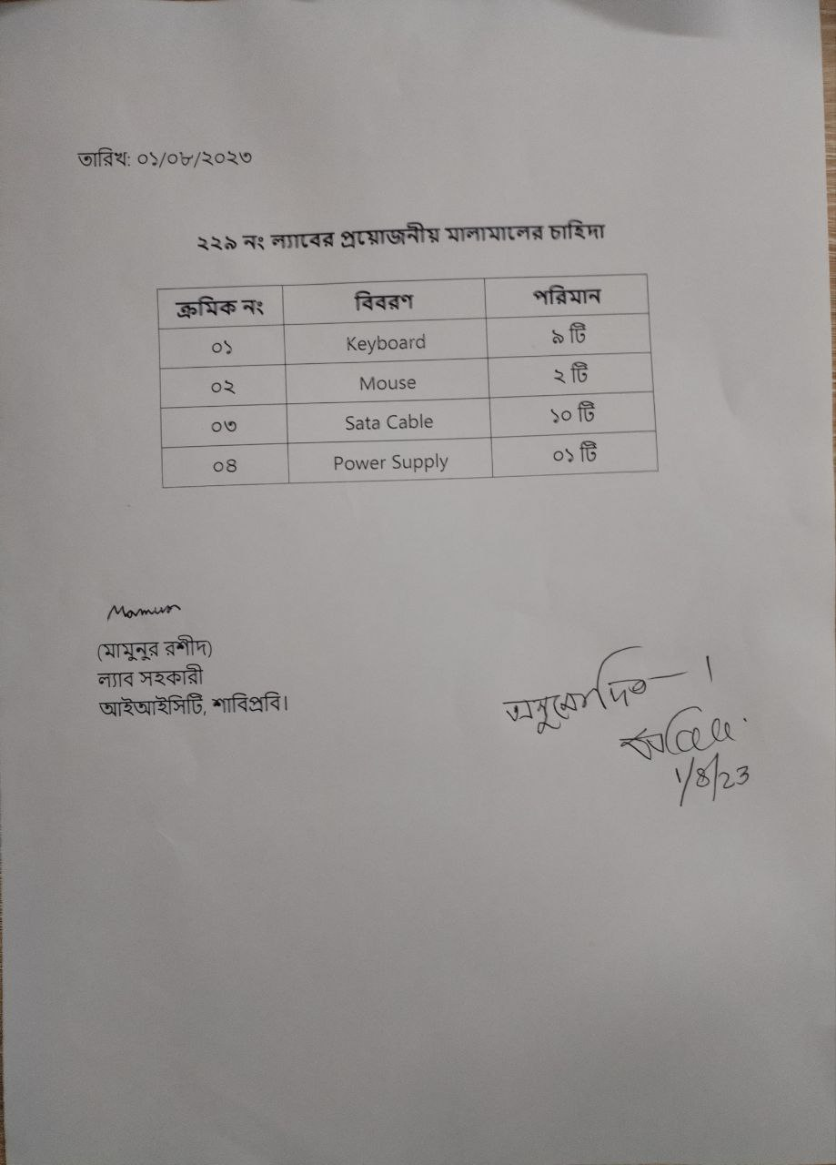
Application & Approval
It is the application page where a person apply for the products and the quantity of that product he wants. It also contains the date of the application. There is also a permitted signature of an authorized person.
04

Slide 5
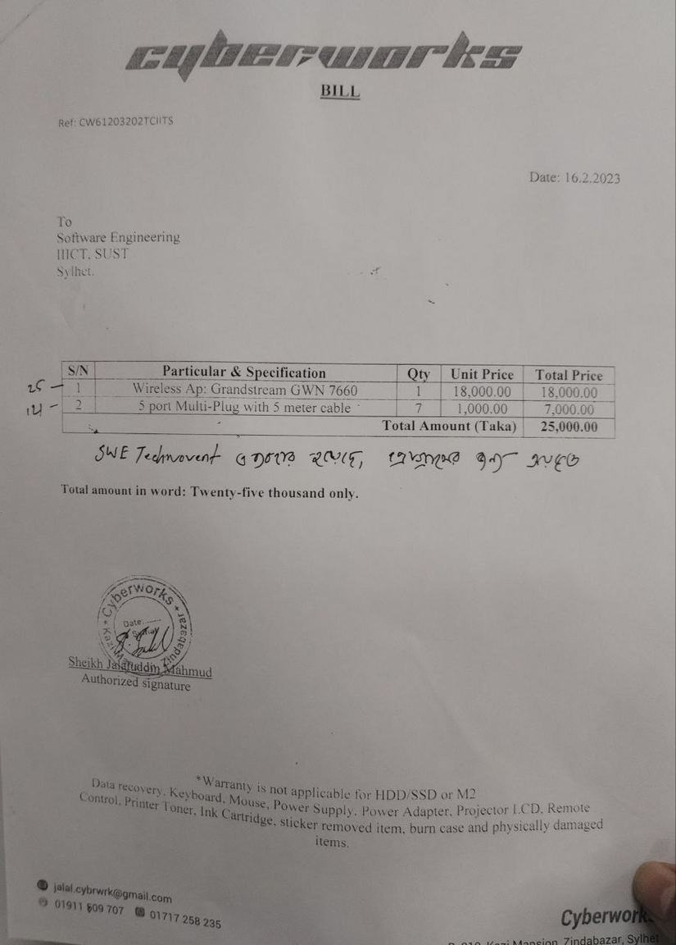
Voucher Page
After delivering the ordered products,
the supplier handover this voucher
with stating the unit price, quantity and
the total price of the products to the
respected authority.
05

Slide 6
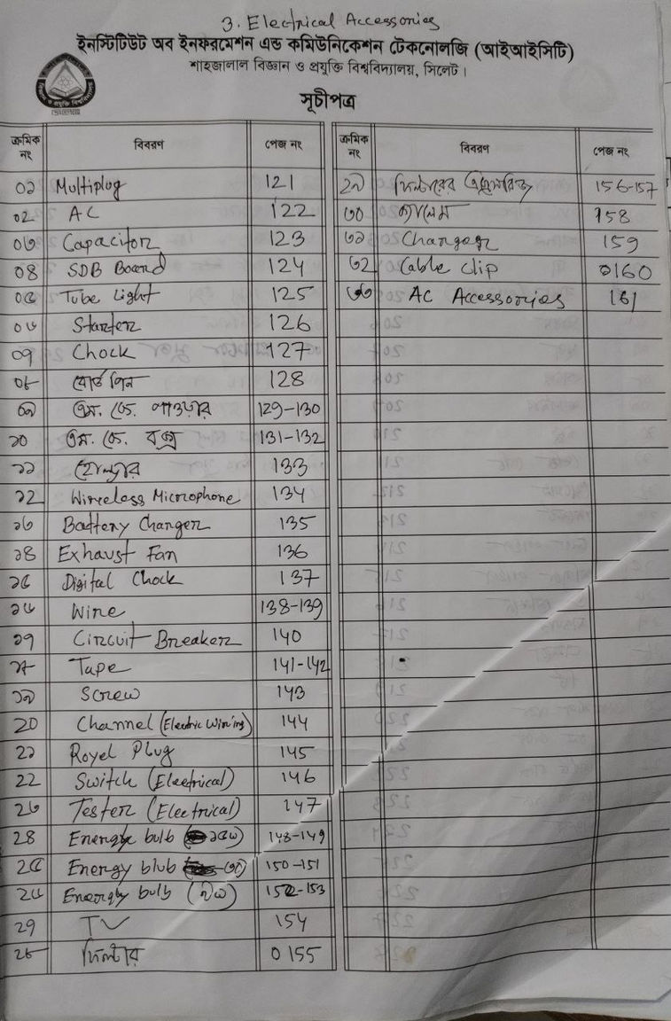
Index of the Log Book
Here all the category of the product that is stored and distributed have written. This manual process of recording information is troublesome
06

Slide 7
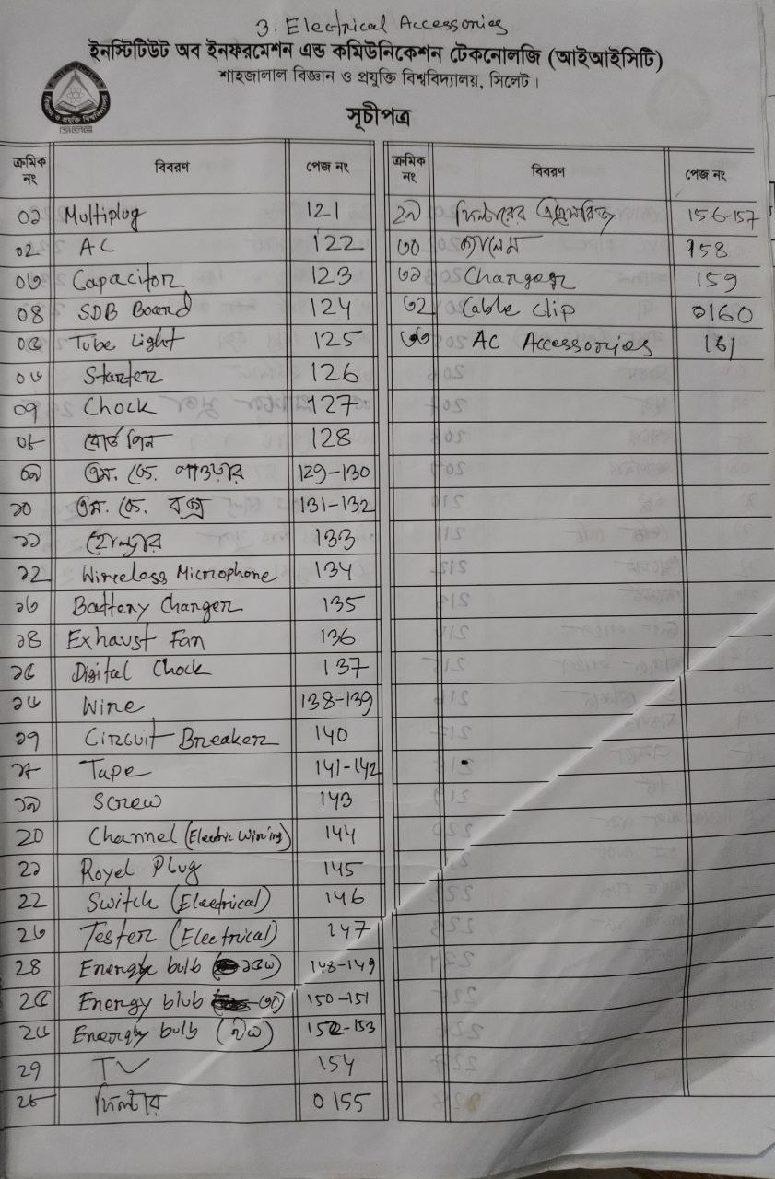

Page Number of Logbook
Different kind of products of Electrical accessories Category is stated in the picture. In the mentioned page beside the product’s name,The product’s detailed information is recorded.
07

Slide 8
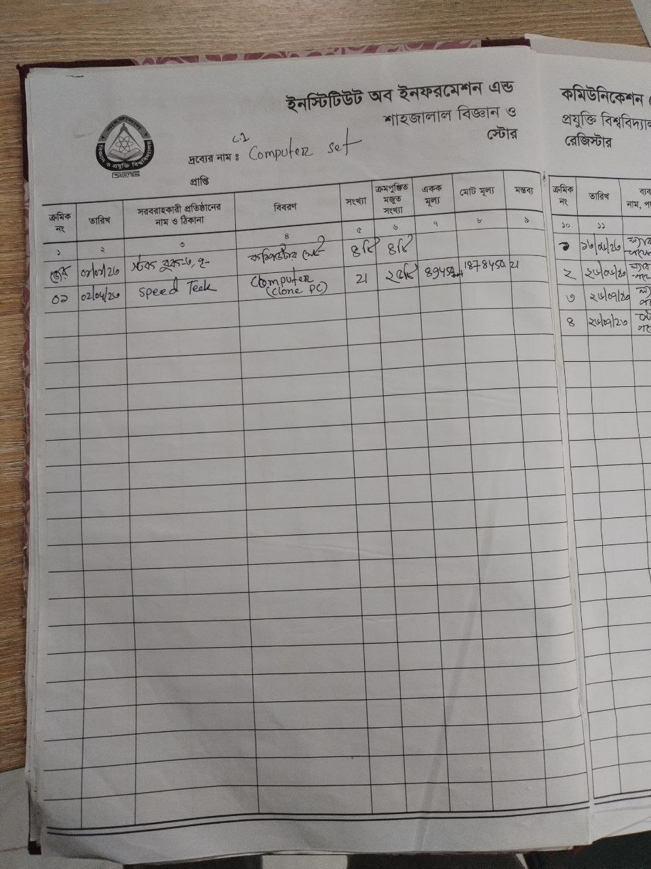

Record Page
The name of the category
Here where the record of storage is
written for specific category
08

Slide 9
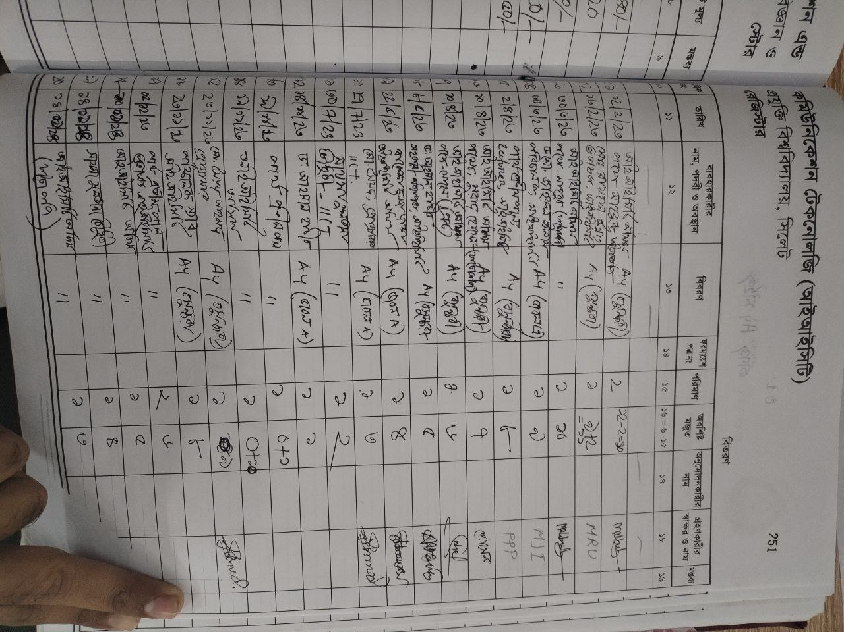
Distribution Information
This page has a date column where the time of the distribution has been written.This page contains the name of the people who has received the product and has the info of distributed product. It also contains information of the quantity of the product and how many product are left in the storage room.
09

Slide 10
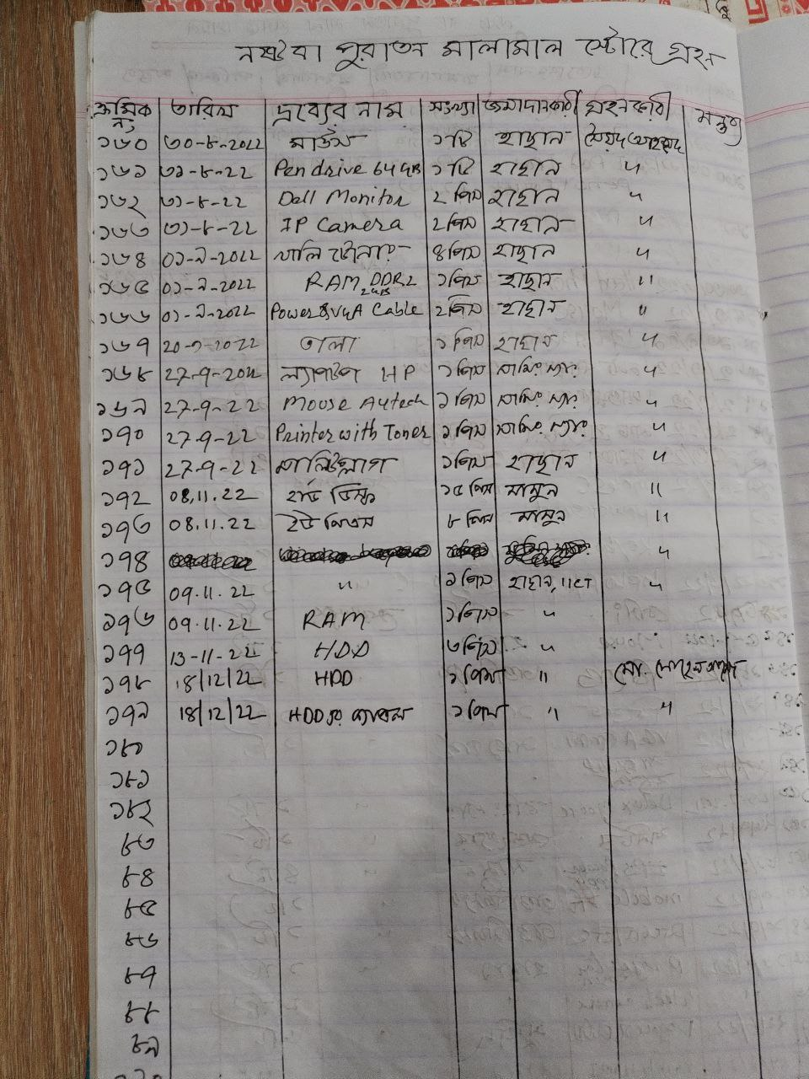

Damaged Products
All damaged and old products are recorded in this page.The date of the deposit is in the second column. It also contains the name of the depositor and what product he was holding. This page also has the information of receiver who received the product.
10

Slide 11
Thank you
Any question?
11

